Slide 1


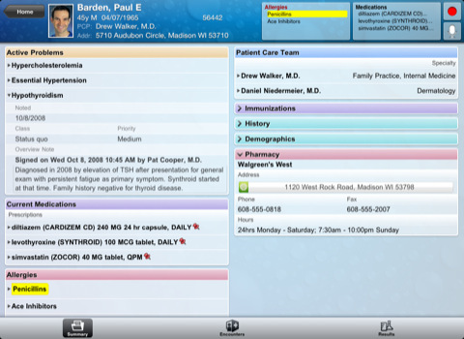
Medication Adherence Support System (MASS): Conceptual Architecture
9
The Intervention Management System tracks the interventions administered and reports back to the model when they’re complete. This is key to measuring efficacy. It can also interact with the MASS Patient App to support automated administration of certain interventions.
1
A patient smartphone app (Android or iOS) reminds patients when it’s time to take medications. Setting up their virtual “pill-box” is made easier by loading the patients’ prescriptions via FHIR from their electronic medical records. If a patient hasn’t taken his or her meds, the app will gently ask the patient to say why. The app will also invite patients to share demographic information that can be used by researches to augment census and other information to help better understand adherence at the community level.
8
Providers can look at the model to see what their patients’ adherence propensity is and why. They can receive alerts suggesting interventions and record that they’re complete. Additionally, community level information is available for communities they’re serving so they can see factors that are relevant to medication adherence. UX simplicity is key to adoption.
MASS Patient App
Intervention Management System
Provider UI and Alert Console
FHIR
2
FHIR ”wiring” will facilitate the exchange of information between the Patient App and the providers’ EHR system(s)
7
”Power Users” can inspect the model to analyze groups of patients and make interventions available in the system. They can also track intervention efficacy using propensity score matching once they’ve been delivered to patients, because the results will be fed back through the model.
3
Healthcare providers will be able to see individual patient medication adherence information through the EHR systems they may use in their office today. Patients can opt to share their data with one or more providers and control what data is shared with each (e.g., multiple doctors, doctor and pharmacy (if supported), etc.).
Adherence Propensity
Model Results
”Power User” MASS UI
6
A UI will be provided for public health professionals to inspect community medication adherence propensity and key influencing factors (community level only—no personally identifiable information).
Provider EHR System(s)
Public Health Professional UI
4
Two Part Predictive Model
5
Adherence Propensity model starting points are informed by structural factors (survival model with mixed effects), but indexed up and down daily by machine learning algorithms whose coefficients adjust as data is processed through the model.
Logic does ETL and enrichment on key data sources daily and provides a rich data set for inspection and use in modeling.
Extract, Transform, Load and Enrich (Daily)
Patient EHR Information
Census Data
MASS Patient Provided
Demographic Info
MASS Patient App
Usage Info
+?
As of December 2,, 2016

Slide 2
MASS Patient Facing App (PFA) – Macro Level Architecture
1
A patient facing smartphone Java App (Android only for this version) reminds patients when it’s time to take medications. Setting up their virtual “pill-box” is made easier by loading the patients’ prescriptions via FHIR from their electronic medical records. If a patient hasn’t taken his or her meds, the app will gently ask the patient to say why. The app will also invite patients to share demographic information that can be used by researches to augment census and other information to help better understand adherence at the community level.
4
The MASS PFA will use SQLite for local data storage.
MASS Patient Facing App (PFA)
2
FHIR ”wiring” will facilitate the exchange of information between the Patient App and the providers’ EHR system(s).
FHIR
MASS PFA App Usage Info, Adherence Information, and Medication Information
3
Healthcare providers will be able to see individual patient medication adherence information through the EHR systems they may use in their office today. Patients can opt to share their data with one or more providers and control what data is shared with each (e.g., multiple doctors, doctor and pharmacy (if supported), etc.).
Provider EHR System(s)
5
Hosted database storage will include application usage information, patient medication adherence information and Medication Information, all indexed by patient and accessible via secure Web Services. Fall 2016 semester’s work may include only limited implementation of the data services layer. As noted in our progress report, this component was not implemented this phase. All data is stored in a SQLite DB in the client app.
As of December 3, 2016

